Slide 1
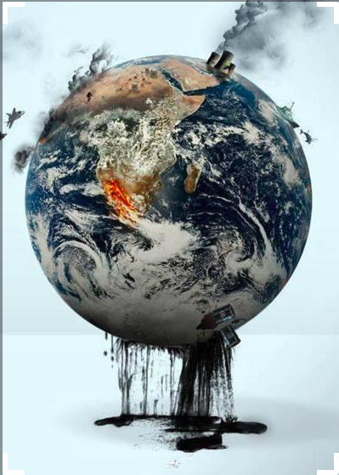
Eco-grief, climate-anxiety, and the student experience
Dr. Jessica Pratt
Associate Professor of Teaching
Ecology & Evolutionary Biology
jdpratt@uci.edu
Notes:
In my classes we are constantly talking about the state of our environment, just how bad things are for the planet, and also what we can do about it and the actions that many groups are taking to stem the tide of environmental destruction currently caused by humanity. It is a lot of depressing news and often I perceive that students don’t feel they are powerful enough or educated enough or in the right position to do something about it. I became very curious about how learning about the state of our environment can impact our student’s mental health, and how I might address this in the classroom.

Slide 2
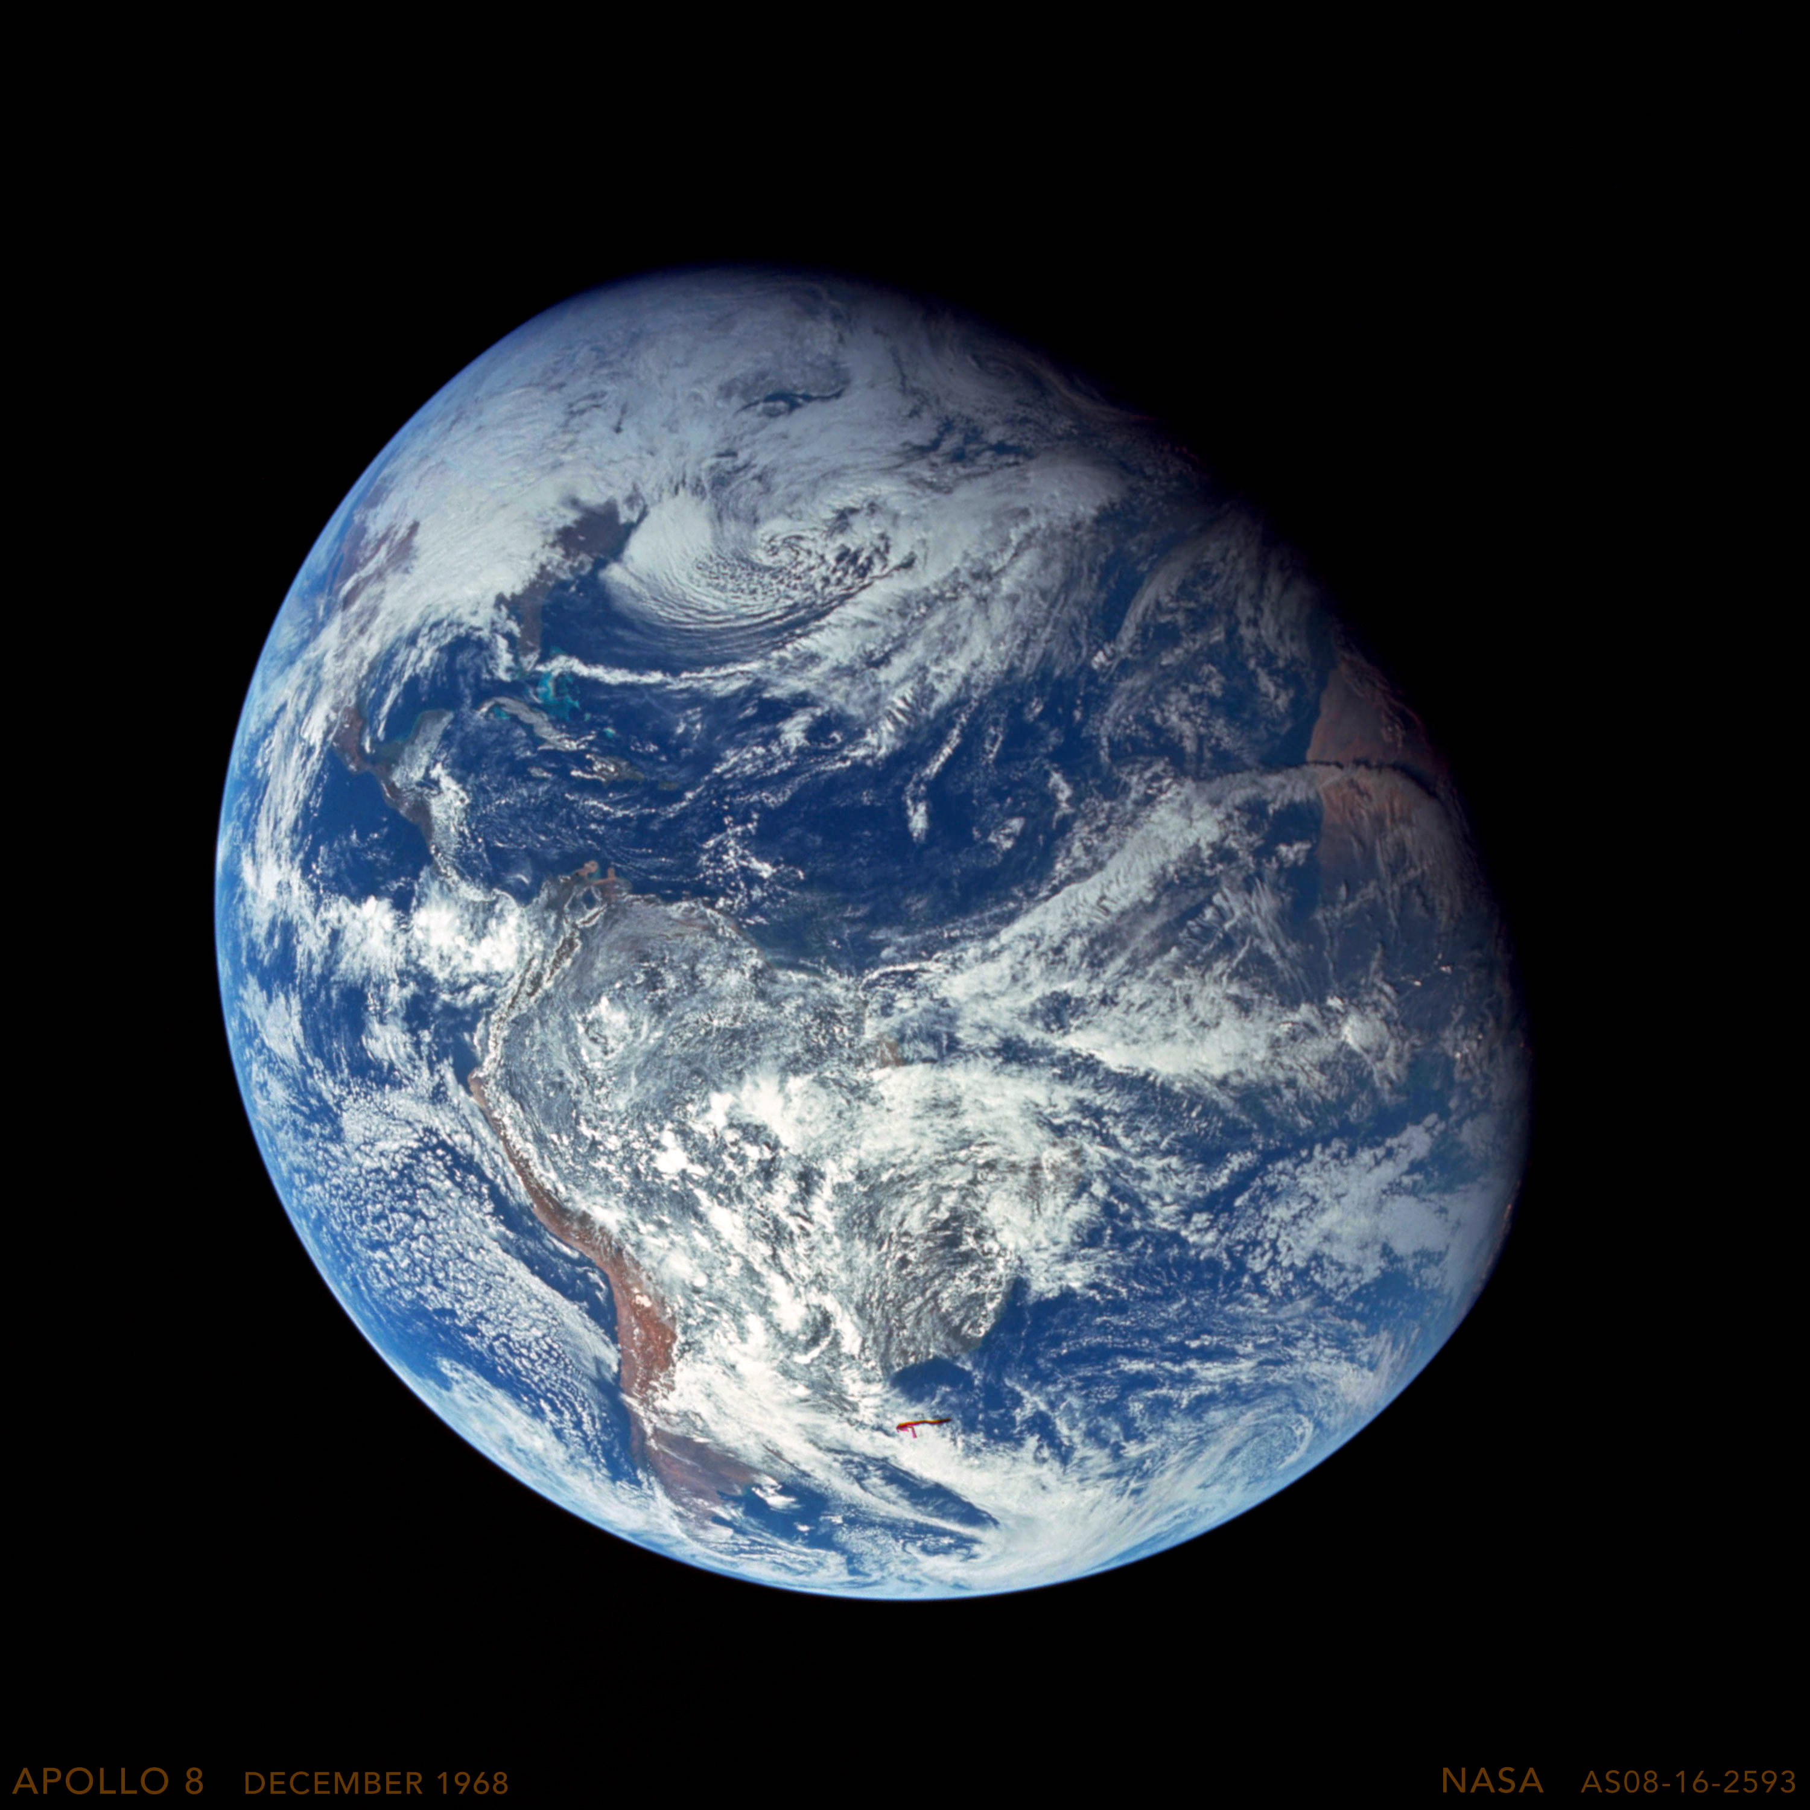
Eco-grief, climate-anxiety, and the student experience
Dr. Jessica Pratt
Associate Professor of Teaching
Ecology & Evolutionary Biology
jdpratt@uci.edu
Notes:
Even the imagery I use in a lecture presentation can elicit different emotions -
I went back and forth a bit about which title slide image to use here because these two images give very different visualizations about the state of our planet, both of which can elicit an emotional response. And both of which may be more or less accurate depictions in some way.
[flip back and forth a few times]

Slide 3
Student Learning Goals
Describe
Describe links between learning about wicked global problems like climate change and emotional well-being
Define
Define eco-grief and climate-anxiety
Consider
Consider your personal psychological and emotional response to various course content
Discuss
Discuss eco-grief and climate-anxiety with peers and devise strategies to turn anger and despair into power, hope and action
Complete
Complete a Personal Change Plan that commits you to at least one action towards creating meaningful change in the world
Notes:
Learning goals for students.
Discuss – really focused on the inner work.
I designed this eco-grief and action planning lesson plan with the idea that the first step in overcoming the psychological effects of eco-grief and climate-anxiety is to be informed about them. I extended this to have students working in community to envision how they can turn those negative emotions into action, hope and change, what they need to believe about themselves and the world to work towards this, what faculty can do to support this, and to guide them through action planning so they had concrete next steps.

Slide 4
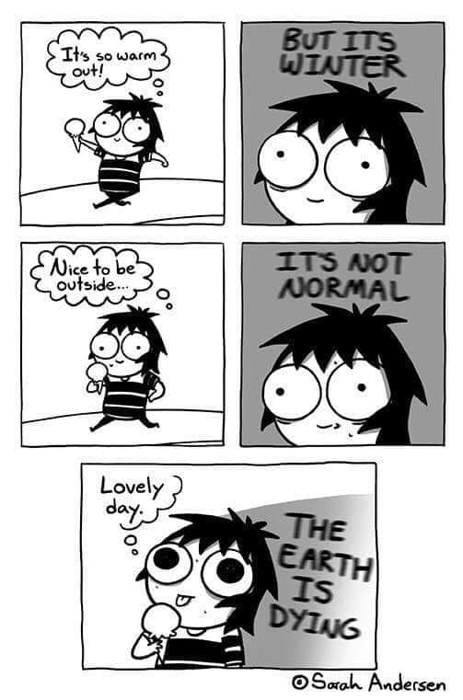
Eco-grief, Climate-anxiety, Pre-traumatic Stress
Students who spend significant time studying global climate change and other planetary crises often suffer emotional distress and anxiety
“the psychological devastation that comes with observing, day-after-day, the growing problems facing the planet.” (Fritze et al. 2008)
Notes:
More recently we are talking about how we FEEL about it all.
About five years ago I became very curious about how learning about the state of our environment can impact our student’s mental health, and how we might address this in the classroom.
This was around the same time that I began reading the published literature on this phenomenon known as eco-grief, or climate-anxiety. There is a whole new vocabulary that has developed around this. These terms describe ”the psychological devastation….”
The premise is that students who spend….
Studies conclude that “understanding the full extent of the long term social and environmental challenges posed by climate change has the potential to create emotional distress and anxiety”

Slide 5
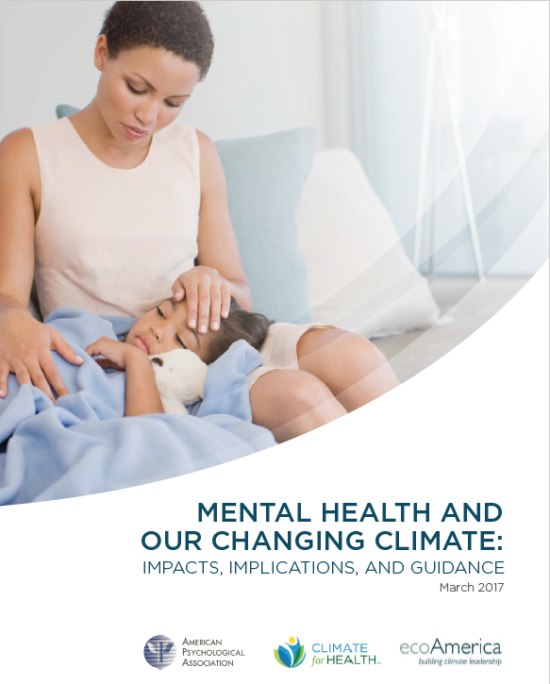
Eco-grief and Climate-anxiety
“To compound the issue, the psychological responses to climate change, such as conflict avoidance, fatalism, fear, helplessness, and resignation are growing. These responses are keeping us, and our nation, from properly addressing the core causes of and solutions for our changing climate, and from building and supporting psychological resiliency.”
Notes:
To help increase awareness of these challenges and to address them, the American Psychological Association and ecoAmerica sponsored this report, published in 2017, Mental Health and Our Changing Climate: Impacts, Implications, and Guidance.
It focuses on the impacts of climate change on mental health and calls for increased attention to the relationship between the psychological impacts of environmental crises and one’s sense of being able to positively contribute to or act on climate solutions, which is exemplified in this quote.
My first question was – whose job is it to build psychological resiliency – I don’t know how to do that for my students. Well, it turns out, I’m learning.

Slide 6
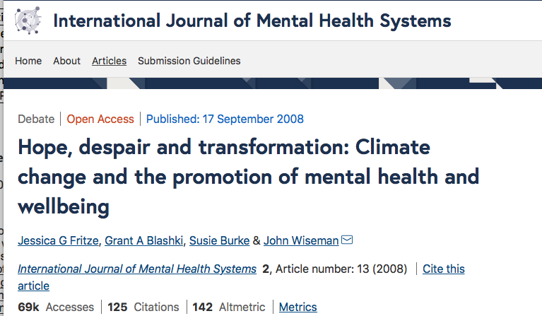
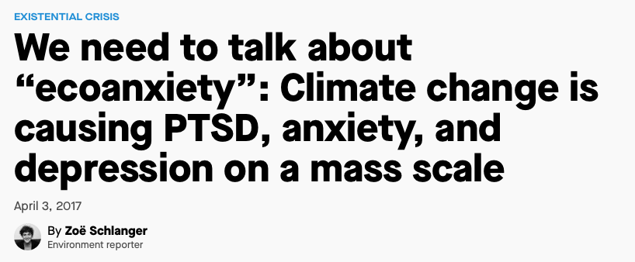
Notes:
There has been a growing awareness of and reporting on this topic in the media and in the scholarly literature – mainly in the field of psychology. But there has been little focus so far on what environmental science educators can or should be doing.

Slide 7
“The positive thing from our perspective as psychologists is that we soon realized the cure to climate anxiety is the same as the cure for climate change – action. It is about getting out and doing some- thing that helps. - Dr. Kennedy Williams
Notes:
One thing that has emerged from this work is a community of professionals dedicated to this research and to helping individuals, families, and organizations move from anxiety to action.
The good news, they say, is that the cure to climate anxiety is the same as the cure for climate change - taking ACTION.
https://www.psychologyoxford.com/climate-project-dr-patrick-kennedy-williams-eco-anxiety
https://www.climatepsychologists.com

Slide 8
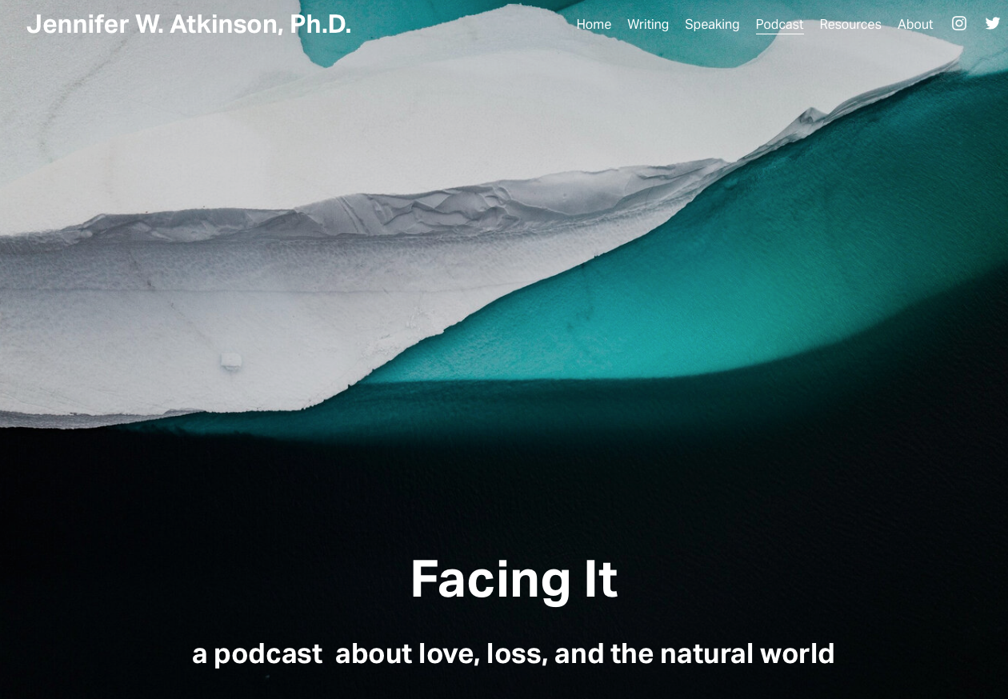
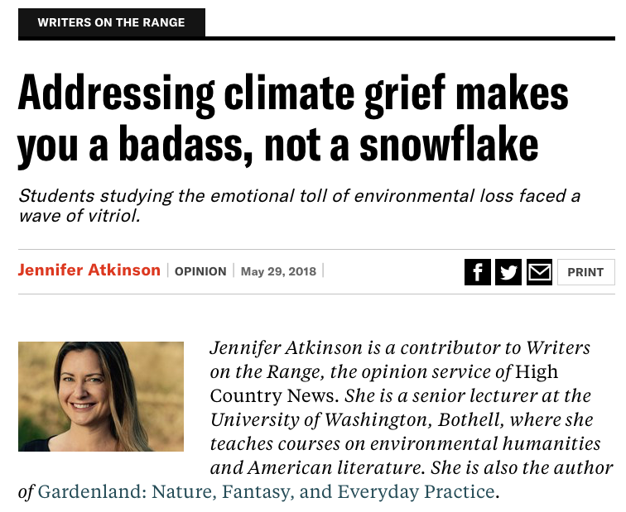
Professor and Chair
Environmental Studies Department
Humboldt State University
Notes:
I will say there is increasing work from environmental educators on this topic, but most of the discussion in the world of teaching and pedagogy on this topic is happening in the environmental humanities.
There are two inspiring women working on this question of “how to keep your cool on a warming planet” and both are writing about how they’ve adapted their teaching and curricula and what they’ve done to address climate grief or anxiety in the classroom.
Excerpt from blog post:
Are you afraid of the end of the world? Do you mourn the loss of coral reefs, polar bears, krill, oxygen, seasons, and other miracles of nature? Is the permafrost under your house melting? Have you given up the hopes of having children, because, hey, what's the point? Are you thinking of taking the eco-mantra "leave no trace" to nihilistic levels of self-erasure? Do you feel helpless in the face of a faceless enemy? Are you feeling guilty because you, as an American, are the most likely to have created all these problems? Do you feel impotent and powerless because practical solutions are, let's just admit it, never gonna happen?
If this sounds like you, you may be suffering from eco-despair. Without proper treatment, eco-despair can quickly lapse into apocalypse fatigue. Once apocalypse fatigue sets in, you're not likely to give a shit anymore. Do something before it's too late.
In Dr. Ray’s book – A field guide to climate anxiety, which was published in 2020 - she proposes that getting informed about the psychological effects of climate change (and other environmental crises) is the first step to overcoming them. While there are plenty of resources for actions individuals or groups can take to combat climate change, there is little focus on the “how to” of personal care – what are the actions we can take in how we think of ourselves, our ability to imagine a future we want to live in and to see ourselves as part of a collective movement in a future of personal abundance. She found out that when she asked her students to “imagine themselves thriving in a climate-changed world” and what their life would look like – they could not visualize that. That inability to imagine thriving in a climate changed future alone impedes working towards it.

Slide 9
KNOWLEDGE IS POWER
Notes:
ASK: What does it take for individuals or groups like this to turn their psychological / emotional response to crises into meaningful action or even “hope”?
Have you heard of sunrise movement or other youth-empowered activist organizations dedicated to taking action on environmental or climate crises?

Slide 11
Show Video
Notes:
https://www.youtube.com/watch?v=N28iaWIzJzg
Before playing the video, ask students to pay attention to the various emotions they witness in the video.

Slide 12
sunriseuci@gmail.com
Notes:
INSERT Sunrise Information for your locale or select another case study / example to include

Slide 13
Group Discussion
In your breakout groups, have each student share a two-minute reflection from their eco-grief writing prompt and discuss your emotional and/or psychological response to learning about global climate change other so-called ”wicked” problems. Have one student in your group serve as the note-taker and add the discussion notes from your group to the jamboard.
Your discussion should focus on the following:
How can you contribute to meaningful change in the world? For instance, how can you harness your fear, anger, despair, etc. and turn it into action, hope, and change?
What do you need to believe about yourself, society, and the world, to commit to meaningful action and feel hope?
What do you need from your community (or professors) to be able to do this?
Notes:
Groups of 5 for 20 minutes.
Put each question on a separate Jamboard.

Slide 14
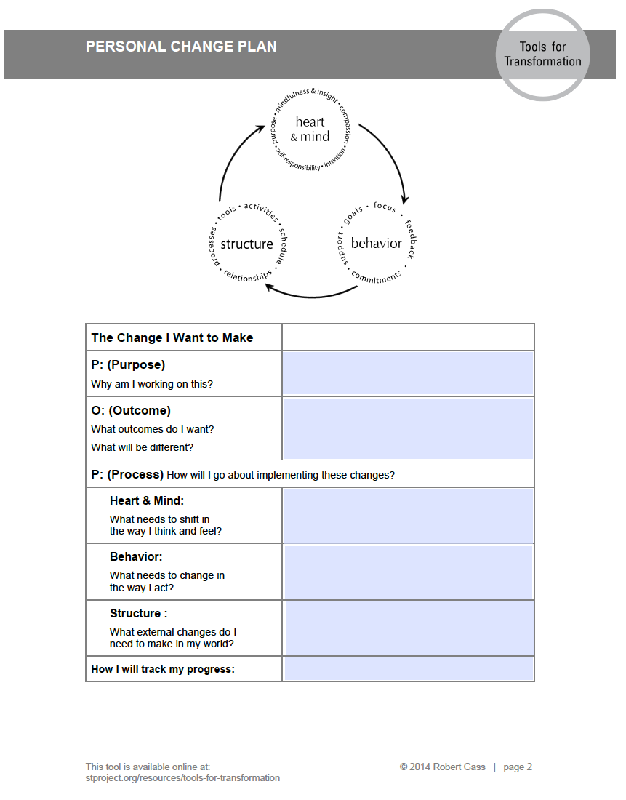
Personal Change Plan
After your discussion, take 5-10 minutes to individually complete and submit the Personal Change Plan worksheet from the Social Transformation Project.
Notes:
End with each student committing to one action – they can share it or not. It could be as simple as signing up for the Sunrise Movement email list, or more ambitious like calling an elected official. This is the first step – just pick one small thing they will do next. Consider having students fill out page 2 of the file Personal Change Plan from the Social Transformation Project (stproject.org)

Slide 15
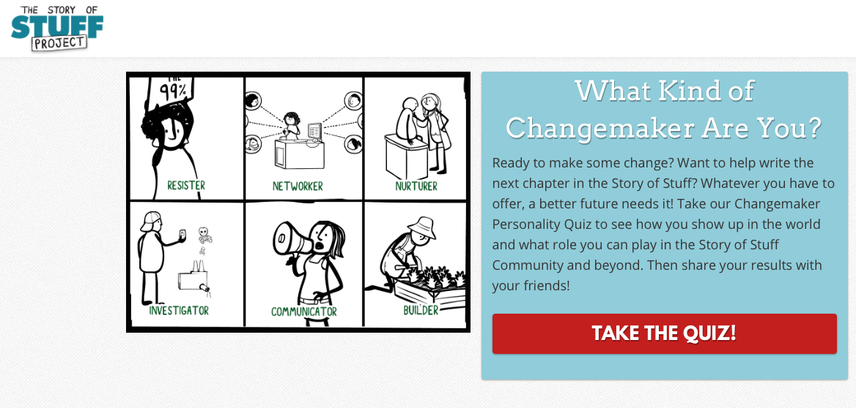
Extension – Take the Changemaker Quiz
http://action.storyofstuff.org/survey/changemaker-quiz/

Slide 16
